Slide 1
Full Duplex MAC Protocols
Sravya M, MT2019114
Swati N Murthy, MT2019120
Guided by: Professor Debabrata Das Sir

Slide 2
Overview
Introduction
Literature Survey
Open Challenges
Novel Idea
Conclusion
References

Slide 3
Abbreviations
HD Half Duplex Mode 00
FD Full Duplex Mode 01
AP Access Point
HOL Head of Line (for the buffer of AP)
WLAN Wireless Local Area Networks
DBTM Destination Based Transmission Mode Mode 10
SBTM Source Based Transmission Mode Mode 11

Slide 4
Introduction
What is Full Duplex Communication?
Half-Duplex vs Full-Duplex
Why Full Duplex?
Self Interference?
How can we achieve Full-Duplex and avoid Self Interference?

Slide 5
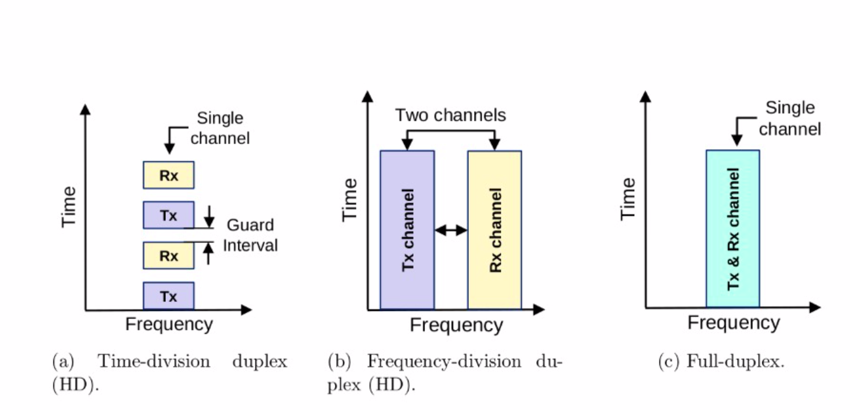
Half Duplex Vs Full Duplex

Slide 6
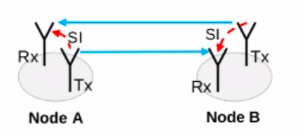
Self Interference
signal
self interference
Physical Layer Protocols:
Passive Suppression
Analog Cancellation
Digital Cancellation
Assumptions:
Fully FD network: All nodes are FD
Mode: infrastructure mode

Slide 7
Literature Survey
Paper1:
Simultaneous Transmit and Receive Operation in Next Generation IEEE 802.11 WLANs: A MAC Protocol Design Approach, IEEE Wireless Communications, December 2017
Concepts:
Modes of Full Duplex Communication between nodes.
Hidden Terminal Problem - How to solve it using FD

Slide 8
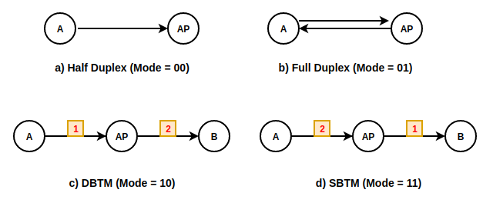
Modes of Operation of FD nodes
DBTM: Destination Based Transmission Mode
SBTM: Source Based Transmission Mode

Slide 9
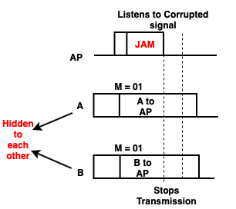
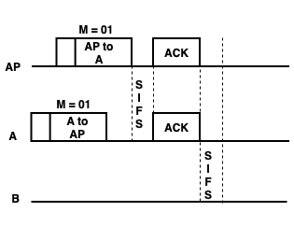
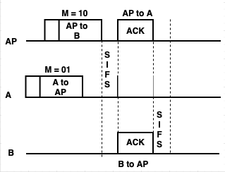
Hidden Terminal Problem-FD resolves
Legacy: RTS/CTS
How FD resolves it without header overhead
A and AP in Bi-directional transmission b) A to AP, AP to other node c) A, B starts at the same time, AP sends a JAM signal

Slide 10
Literature Survey
Paper2:
Medium Access Control Design for Full Duplex Wireless Systems: Challenges and Approaches, IEEE Communications Magazine, May 2015
Concepts: 2 MAC protocols
Virtual Contention
Header Snooping

Slide 11
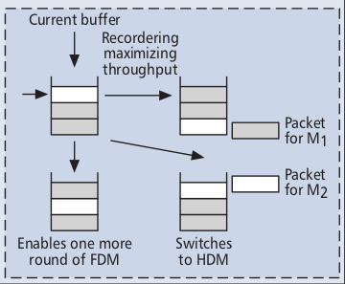
Virtual Contention Resolution
AP can transmit packets (other than HOL) from buffer to increase the throughput.
Ex: M1 initiates transmission to AP, if AP’s HOL is not for M1, AP searches in buffer for a packet to M1 and sends to M1.
M1
AP

Slide 12
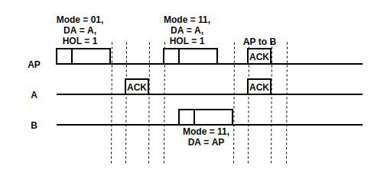
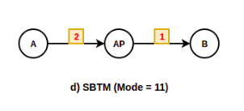
Header Snooping
Header Snooping is reading packet headers going through the channel.
Here, node B snoops the packets in the channel. On hearing mode of AP as 11, it gets to know that AP is free for receiving data. It can directly start transmitting.

Slide 13
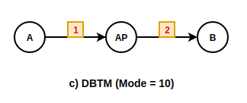
Challenges
Virtual Contention: Delaying HOL is not always feasible, starvation
Header Snooping: Collision may take place
High processing capability and sufficiently large buffers are required for simultaneous transmission and reception.
Selection of 3rd node in uni-directional transmission has to be taken care by AP.
(If B and A are in interference range (not hidden to each other), signal A->AP and AP->B will both reach B and B receives corrupted packets.)

Slide 14
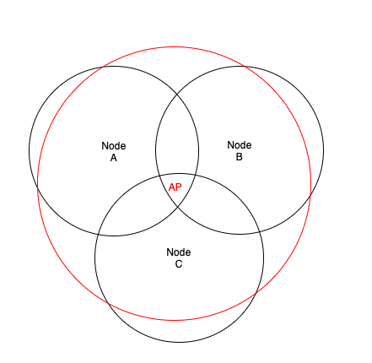
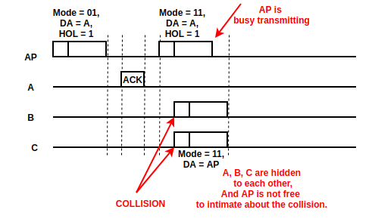
Header Snooping: Collision Scenario in FD
A, B, C are hidden to each other

Slide 15
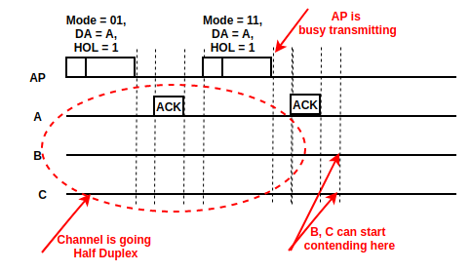
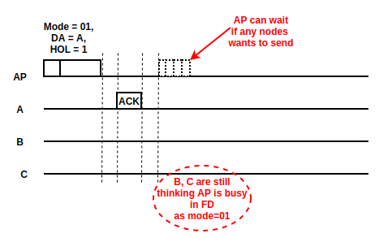
Possible workarounds
Contend after AP’s packet?
Can we make AP wait to receive?

Slide 16
Novel Idea
How will the nodes know if they can contend before knowing the mode 11 of AP (i.e., AP is free for receival)?
We are introducing a bit in MAC packet header to know if AP initiated the communication.
API (Access Point Initiated Communication) = 1 if AP initiates the communication.
Also introduced an algorithm for the new back off counter for contending nodes in this scenario.

Slide 17
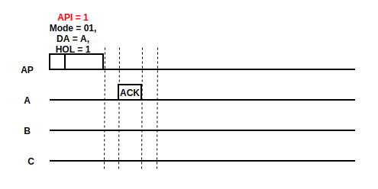
Adding a bit to Packet Header (API)
API = AP initiated transmission bit
AP will be in Mode = 01 in 2 cases.
A has initiated the transmission and A, AP are in FD communication.
AP has initiated the transmission to A. AP may be free for receiving if A is not having data for AP.

Slide 18
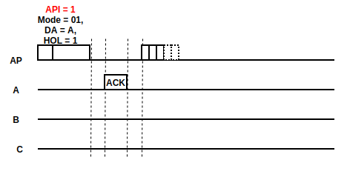
AP will wait for 5(avg) time slots
After the 1st AP initiated packet, if HOL=1 for A
AP receives an ACK from A
In our algorithm, for exploiting FD communication, AP has to wait for some time to see any node is ready to contend for the channel.
Note: The nodes cannot directly send as in Header snooping, they need to contend to avoid collision.

Slide 19
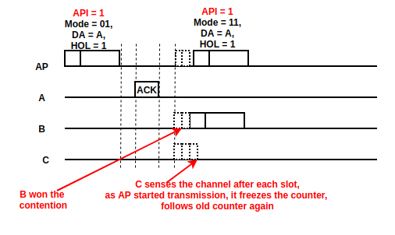
New Back Off Counter for contending nodes
New_backoff = old_backoff * 0.01
Ex:
Let B has old_backoff = 120,
new_backoff = 1.2 slots,
C has old_backoff = 535,
new_backoff = 5.35 slots
B won, So C changes the counter to old, freezes.

Slide 20
Algorithm
Let AP have data packets to A as HOL packets. AP invites A for a FD communication with Mode = 01, HOL = 1, API = 1.
If A has a data packet to AP, it starts an FD communication.
Else, it responds with an ACK.
At this point, AP has to wait for a 5(avg) to 10(max) slot times to see if any of the nodes are interested in transmission.
The nodes which have freezed their back off counters and are waiting for the channel to be free, will snoop the packets in the channel.
Once they see the AP packet header with API = 1, they will wait for a Packet Time + ACK, and sense if the channel is free. If free, they starts contending for the channel.
they start new_backoff_counter=old_backoff_counter*0.01. once the counter becomes 0, the node can start transmission if the channel is free.
Once AP receives a bit, it resumes its transmission. Other nodes will get to know that channel is occupied, change back off to old_backoff_counter and freeze it.

Slide 21
Conclusion
FD can improve throughput gain.
FD reduces congestion, end to end delay as nodes can simultaneously transmit and receive.
Avoid signalling overhead.
Future scope is there on physical layer protocols too.
In checking the energy consumptions of the Full Duplex node antennas.
Efficient Self Interference suppression protocols are needed.

Slide 22
References
Simultaneous Transmit and Receive Operation in Next Generation IEEE 802.11 WLANs: A MAC Protocol Design Approach, IEEE Wireless Communications, December 2017
Medium Access Control Design for Full Duplex Wireless Systems: Challenges and Approaches, IEEE Communications Magazine, May 2015
Energy Efficient MAC Protocol for Wireless Full-Duplex Networks, China Communications, January 2018
Full Duplex Techniques for 5G Networks: Self-Interference Cancellation, Protocol Design, and Relay Selection, IEEE Communications Magazine, May 2015
Full-Duplex Transmission in PHY and MAC Layers for 5G Mobile Wireless Networks, IEEE Wireless Communications, October 2015
Full-Duplex Wireless Communications: Challenges, Solutions, and Future Research Directions, Proceedings of the IEEE, July 2016

Slide 23
Thank You!

